Slide 1






Services
About us
Contact us
Business Consulting Services
Strategy Redefined. Growth Reimagined.
Customized strategic consulting solutions for achieving
exponential growth in a hyper-competitive landscape
Schedule your 30 Minute Complimentary Consultation
Notes:
Headliner – Merriweather Bold 700
Under writing - Montserrat – Medium 500 font

Slide 2
Win & Win Big
For growth-minded organizations, in highly competitive sectors, seeking to build scalable and sustainable infrastructure. Synergy5 is the catalyst for surpassing your profitability targets over the long run.

Slide 3
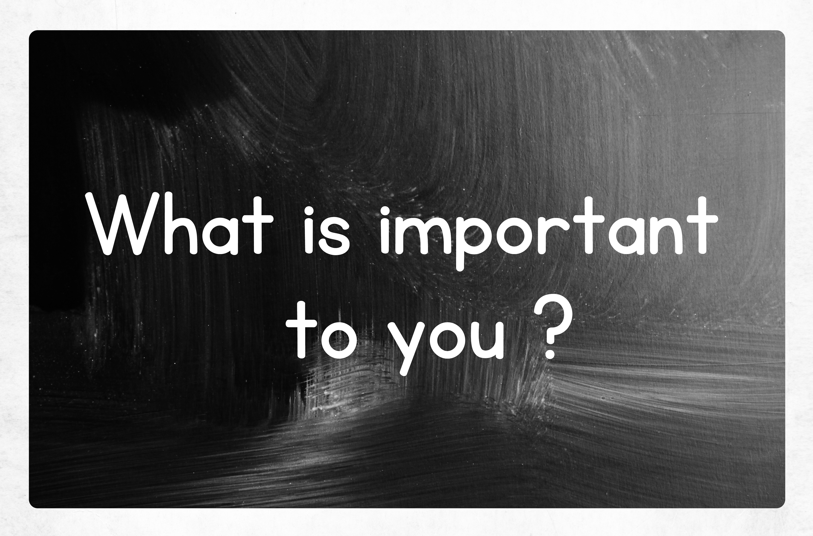
We have one goal:
To help you achieve yours!
We support your needs and go to work on helping you realize a higher level of success.
Our job is to help you achieve wins in the short term, but also build infrastructure, scale, and consistency that will help you develop talent and empower your team to drive success and market share for the years to come.
Schedule your 30 Minute Complimentary Consultation

Slide 4

OUR APPROACH TO DRIVING VALUE TO YOUR ORGANIZATION:
Eliminates barriers to ensure operational excellence
Identifies and builds existing capabilities at scale to drive structural change
Strategically positions your talent, aligning to organizational strategic objectives
Turns one-time customers into lifetime champions
Recognizes opportunities to close gaps and gain market share

Slide 5

Synergy5’s Essential start up Framework
Our mission is to encompass your vision and passion to create a culture and direction that creates a best in class experience for your customers.
Go To Market with Confidence
Strategy and Planning
Build a Culture of Success
Schedule your 30 Minute Complimentary Consultation
Notes:
Go To Market with Confidence
Implement competitive advantages that top startups use to succeed, gain user feedback, and develop product-market fit that captures your target customer.
Strategy and Planning
We capture your ideas and build a firm with a flexible strategy with critical thinking, careful planning and measurable outcomes.
Build a Culture of Success
Communication is the cornerstone of any successful product team. We help you to to align with key stakeholders and improve your processes, tools and personnel so that the flow of information yields the expected results.

Slide 6
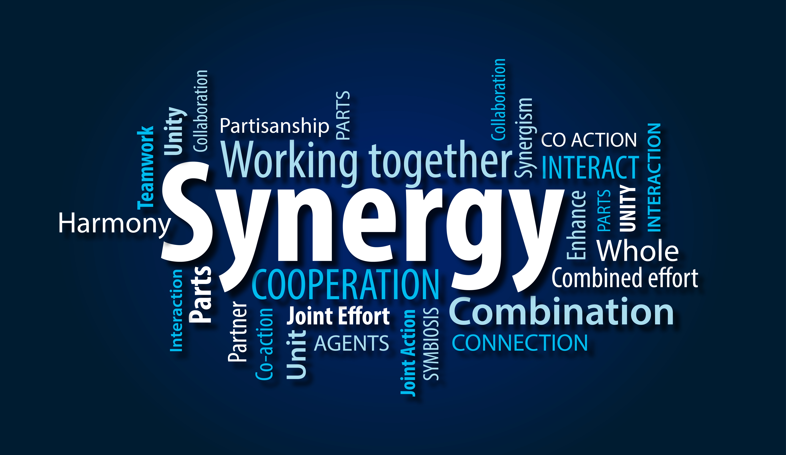
Ready to get started?
Schedule your 30 Minute Complimentary Consultation

Slide 7
SUBSCRIBE
Gain valuable insight proven to help you streamline your business.
Connect
XXXXX@synergy5.com
COMPANY
About
Privacy Policy
Terms of Service
Email Address
SIGN UP
COPYRIGHT © 2019 FCO, LLC. ALL RIGHTS RESERVED

Slide 8
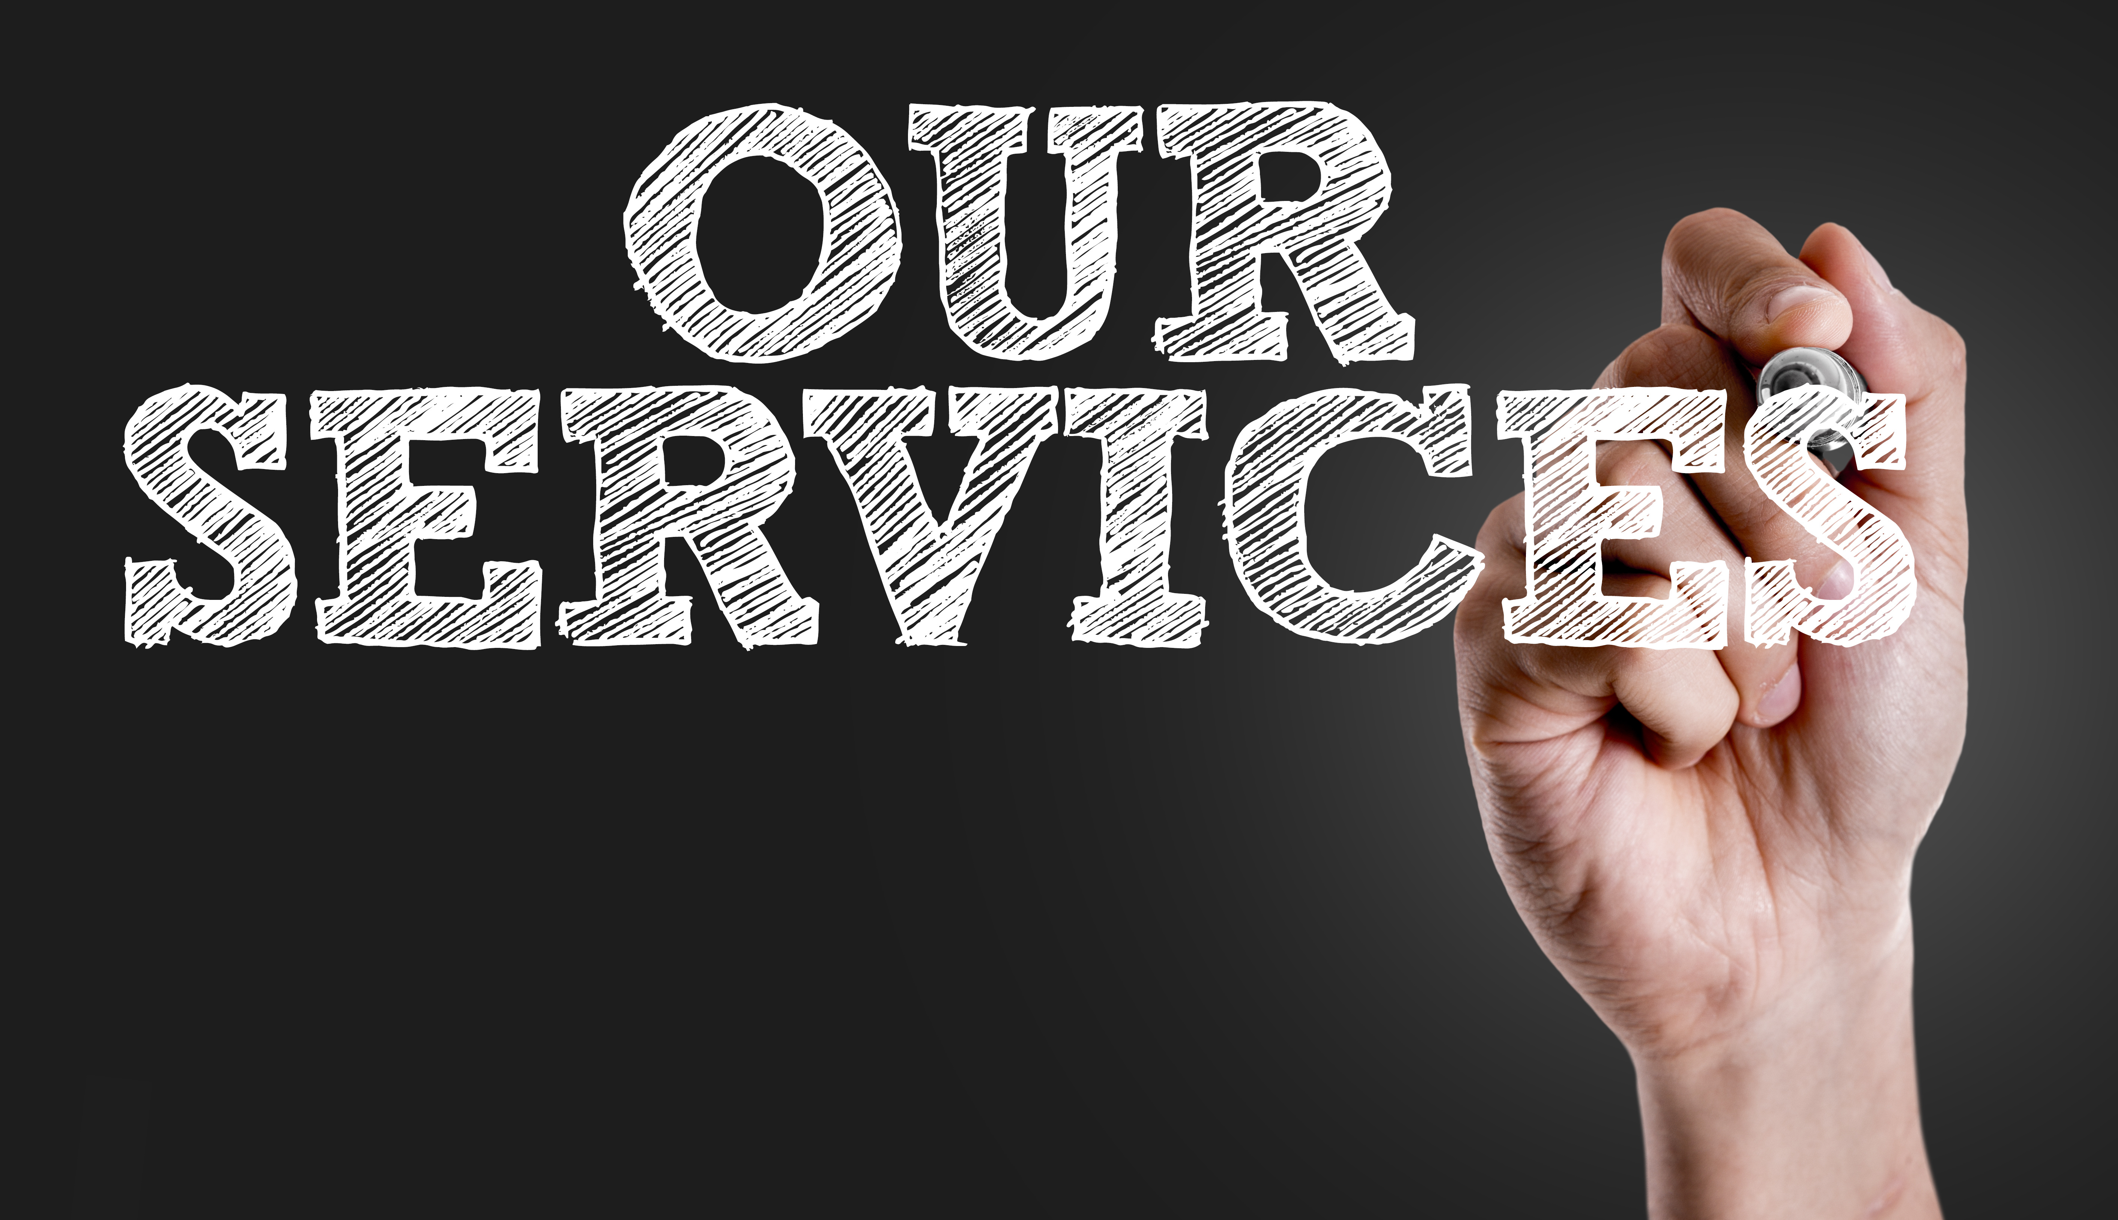
Services
About us
Contact us
Services:
Strategic direction and execution
Diversity, Equity and Inclusion
Talent Development
Customer Centricity
Start-up Businesses & strategic planning/execution
Notes:
Headliner – Merriweather Bold 700
Under writing - Montserrat – Medium 500 font

Slide 9
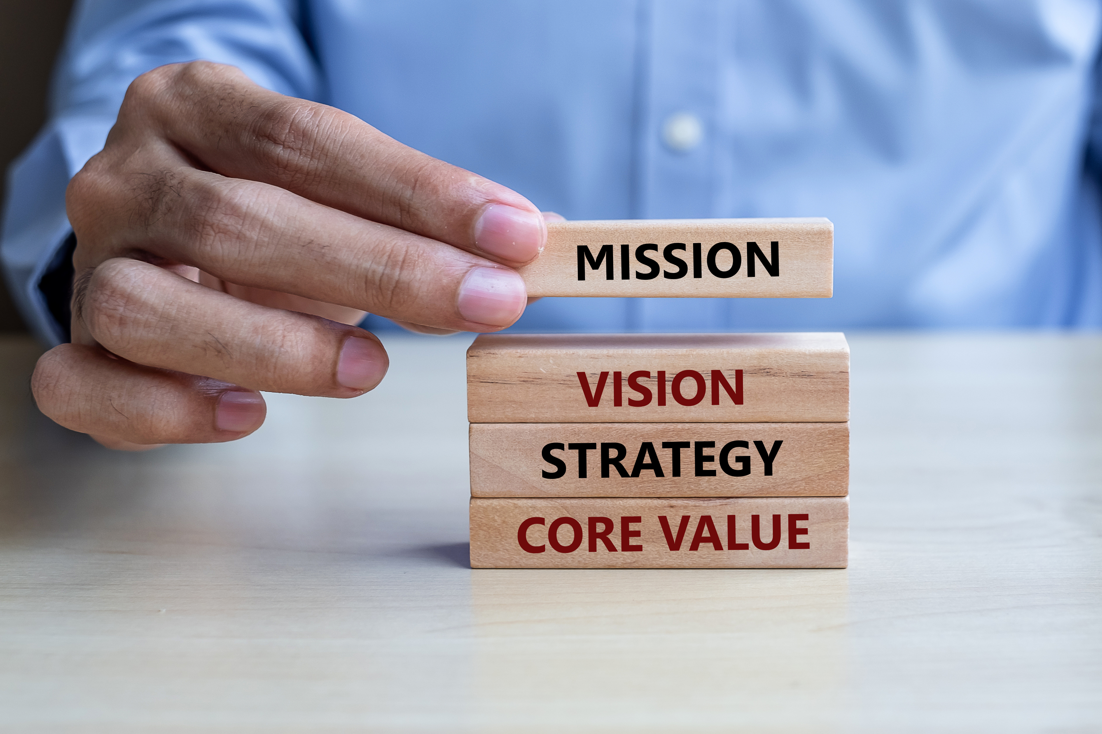
Services
About us
Contact us
Strategic direction and execution:
Every step of the way, Synergy5 works closely with you to build business strategies that reflect your corporate values, while flexing where necessary to promote your enterprise goals.
Our focus areas
Organizational Design
Operating Model
Capacity Analysis (workload)
Process redesign
Organizational change management
Notes:
Headliner – Merriweather Bold 700
Under writing - Montserrat – Medium 500 font

Slide 10
Services
About us
Contact us
Diversity, Equity and Inclusion:
Are you creating a sense of belonging for your employees?
Synergy5 helps organizations ground what they do in diversity, inclusion, equity and belonging. Our approach to creating a workplace where everyone feels they belong is not only critical to the success of people, and your business.
Our focus areas
Commitment to a diverse environment
Retention
Inclusion
Brand Reputation
Financial performance
Notes:
Headliner – Merriweather Bold 700
Under writing - Montserrat – Medium 500 font

Slide 11
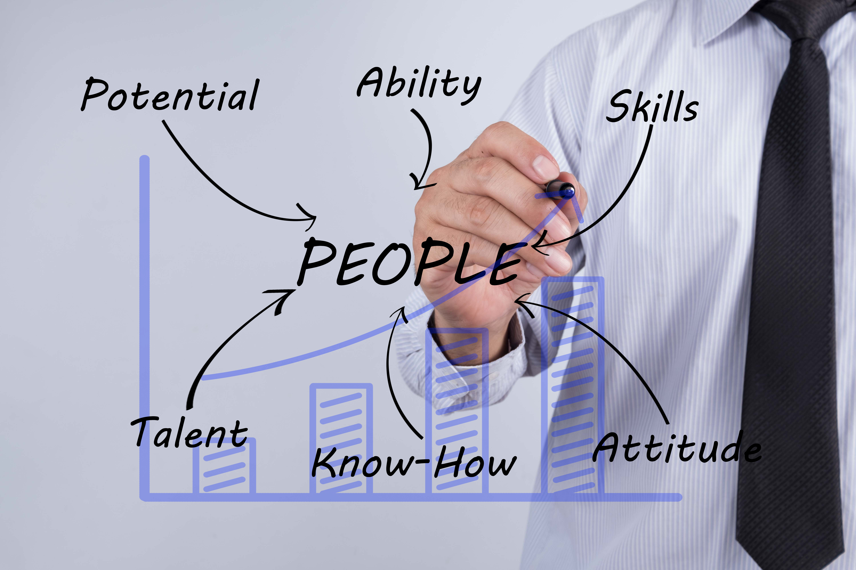
Services
About us
Contact us
Talent Development:
Align your talent to your business strategy.
In tough times, organizations that can adjust their strategies and align their people accordingly will thrive. Synergy5 helps you leverage your unique culture and employee abilities to create talent strategies that make business success consistent.
Our focus areas
Culture and core values
Competency modeling/career paths
Performance management
Leadership Development
Training strategy and design
Notes:
Headliner – Merriweather Bold 700
Under writing - Montserrat – Medium 500 font

Slide 12
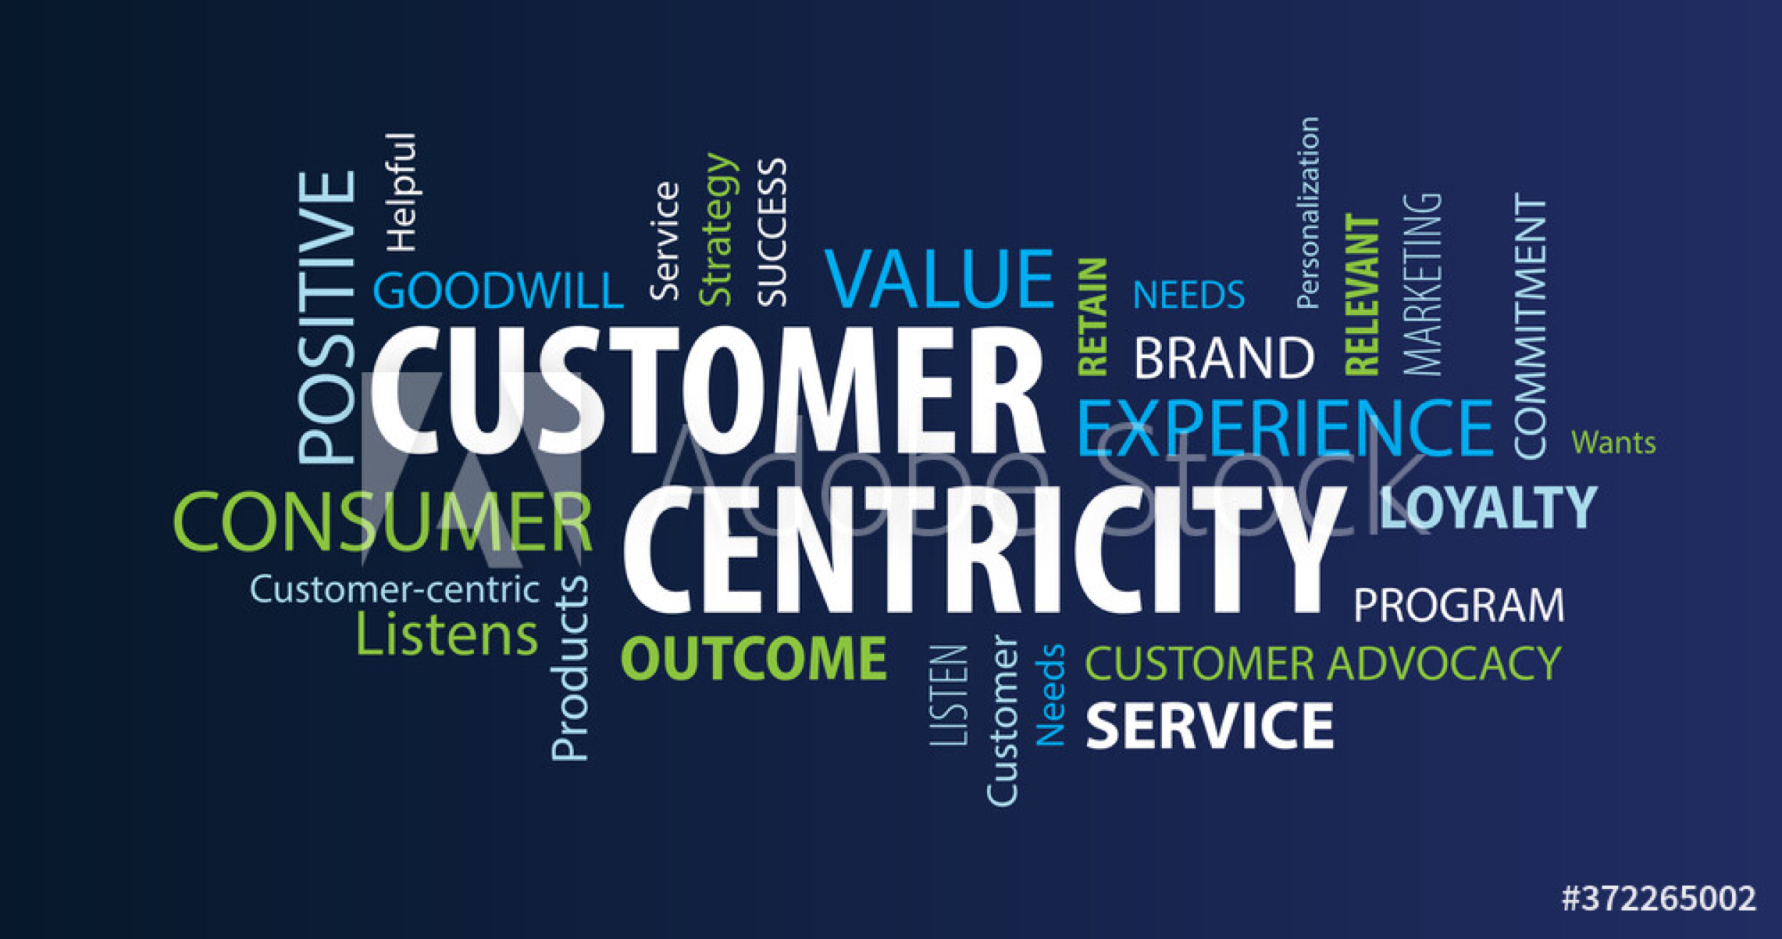
Services
About us
Contact us
Customer Centricity:
Loyal customers drive organic growth. Synergy5 will help your company become more than just "customer focused.” In driving customer centricity, we will help you to make customer engagement a core priority in your organizational culture, which will allow your leadership team the ability to build and sustain your customer-centric culture.
Our focus areas
Understanding your Customer
Designing engaging experience
Enabling and Empowering your workforce
Delivering high standards of service
Retain and grow customer base
Notes:
Headliner – Merriweather Bold 700
Under writing - Montserrat – Medium 500 font
Gallup Reference on this page

Slide 13

Services
About us
Contact us
Start-up Businesses & strategic planning/execution:
Synergy5 works collaboratively with startup companies, applying our expertise, and oﬀering guidance in all aspects of building a business. From formulating strategy and developing business models, to crafting value propositions and optimizing pricing.
Our focus areas
Idea Creation - Development
Professional Business Plan
Business Model Improvements
Execution
Project Management
Continued Mentorship Post business launch
Notes:
Headliner – Merriweather Bold 700
Under writing - Montserrat – Medium 500 font

